Slide 1
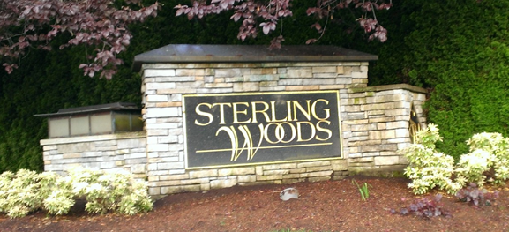
Sterling Woods HOA Meeting Monument Repairs
May 7, 2013

Slide 2
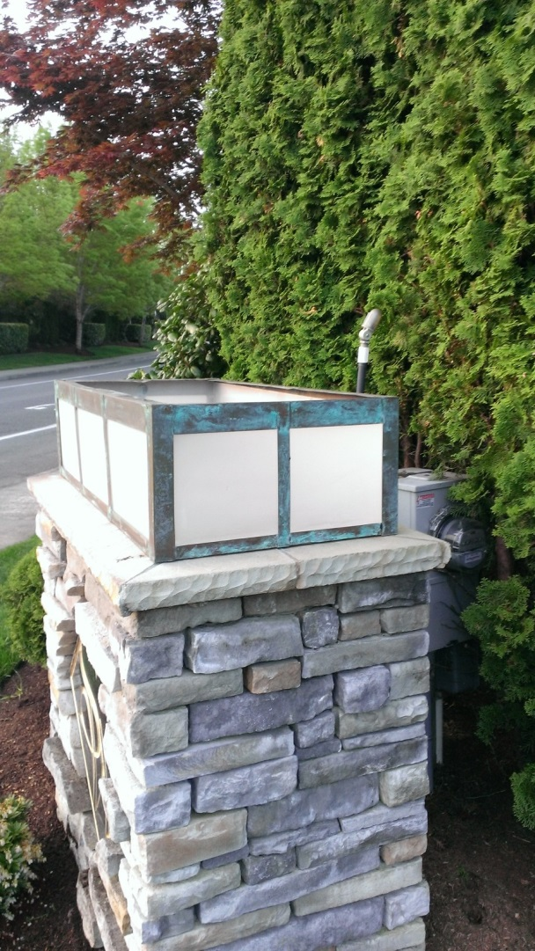
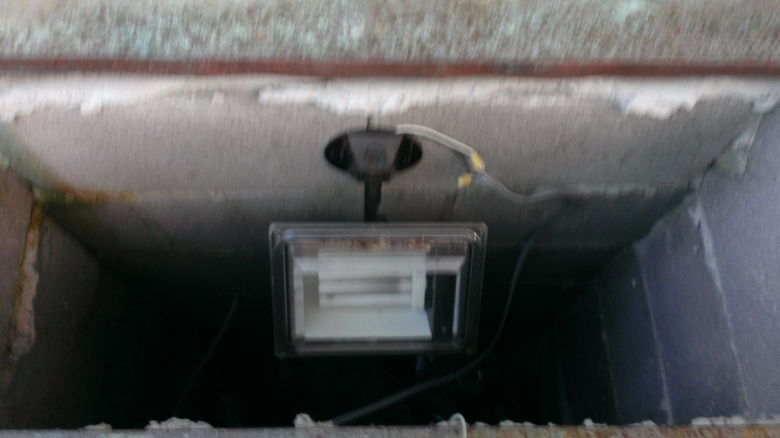
Some repairs are required
Electricity / current to each monument
Access to change light bulbs
Fixture repair, wiring, mounting

Slide 3
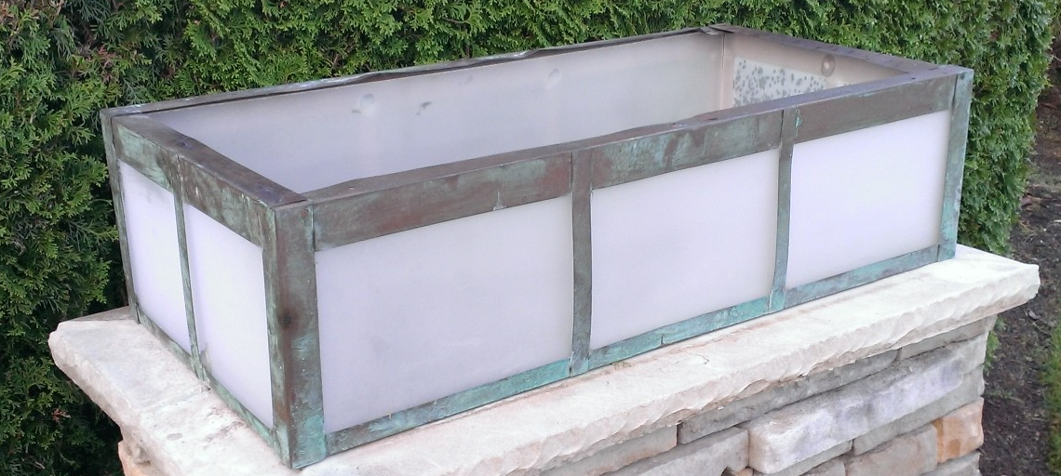
Lighting Frames
Flimsy and copper. May encourage future theft and may not support or secure new caps sufficiently.
Access to lighting fixtures difficult.

Slide 4
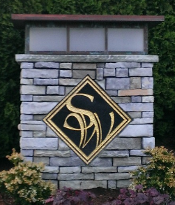
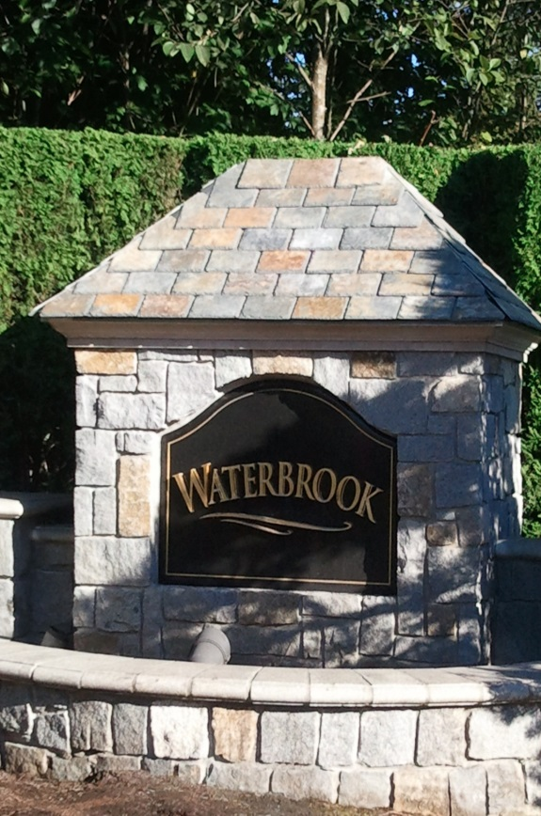
Styles Considered
Flat top
Wooden frame with architectural shingles
Replacement with a metal cap of similar architectural styling as originally designed.

Slide 5
Costs
Several contractors engaged. Two formal bids submitted.
$8,200 for 8 units. $800 for lighting units reconstruction.
$8,400 for 8 new units to include reconstruction of lighting frames for rigidity and access.
Irrigation, soil treatments and landscaping to beautify each monument is an additional $2,700.
Total anticipated costs $11,100 plus materials for electrical updates Robert Angliss has volunteered to perform.
Ted Hawksford has already repaired the monument with stonework damage.

Slide 6
Recommendation
Replace with galvanized metal caps of similar architectural styling and color to original.
Update lighting frames and access for ease of bulb replacement.
Update landscaping as needed for beautification and sustainability
… all for a low, one time assessment of $175 per household

